Slide 1
WEB APPLICATION DEVELOPMENT TRAINING
DATABASE TABLE JOIN
24/08/2017

Slide 2
SQL JOIN
The SQL Joins clause is used to combine records from two or more tables in a database. A JOIN is a means for combining fields from two tables by using values common to each
An SQL INNER JOIN returns rows when there is a match in both tables
INNER JOIN is the same as JOIN.
If there are rows in the "Customers" table that do not have matches in "Orders", these customers will NOT be listed.

Slide 3
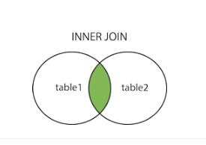

Slide 4
SQL LEFT JOIN
The LEFT JOIN keyword returns all rows from the left table (table1), with the matching rows in the right table (table2). The result is NULL in the right side when there is no match.
In some databases LEFT JOIN is called LEFT OUTER JOIN.
This means that a left join returns all the values from the left table, plus matched values from the right table or NULL in case of no matching join predicate.

Slide 5
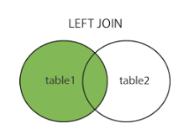

Slide 6
SQL RIGHT JOIN
The RIGHT JOIN keyword returns all rows from the right table (table2), with the matching rows in the left table (table1).
The result is NULL in the left side when there is no match.
In some databases RIGHT JOIN is called RIGHT OUTER JOIN.

Slide 7
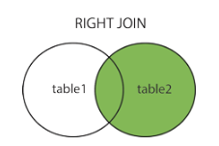
Notes:
1. The basic syntax of LEFT JOIN is as follows:
SELECT table1.column1, table2.column2... FROM table1 LEFT JOIN table2 ON table1.common_filed = table2.common_field;
2. The basic syntax of RIGHT JOIN is as follows:
SELECT table1.column1, table2.column2... FROM table1 RIGHT JOIN table2 ON table1.common_filed = table2.common_field;
3. The basic syntax of INNER JOIN is as follows:
SELECT table1.column1, table2.column2... FROM table1 INNER JOIN table2 ON table1.common_filed = table2.common_field;

Slide 8
Assignment
My birthday is in November, I will be posting an invite on my facebook wall to invite as many people as possible but I want to be sure I have the details of the people coming.
My guests have the option of coming with any of these gift items:
Car, Blender, Shoe, Cloth or Cash
I am ready to pay you N50,000 to design a web app to handle this, I want to be able to know the state each of my guest is coming from as well as the gift(s) they will be coming with.
Using the db designed in class (attached):
1. Design an appropriate interface using your knowledge of HTML, CSS, Bootstrap
2. Write a query that will get me the details (phone number, fullname) of guests that will come with a cash gift
3. Write a query that will get me all the guests from Zamfara, they deserve a special recognition...
4. Write me a query that will get me all the details of the female guests.
5. Write a query that will get all the guests that didnt supply their phone number during registration.

